Slide 1


Python for Data Analysis
& Automation
A hands-on introduction for bioengineering researchers
Abdullah Al Bashit, PhD
Postdoctoral Research Associate
Department of Bioengineering
Northeastern University, Boston, MA, USA
March 27, 2026
Notes:
Welcome everyone! I'm Abdullah Al Bashit. This session will give you the tools to automate your data analysis — beginner-friendly, no prior Python experience needed.

Slide 2








Agenda
1
Why Python?
Motivation & advantages
2
Getting Started
Environments & tools
3
Python Basics
Variables, functions, packages
4
Case Study: qPCR Pipeline
ΔΔCt method, end-to-end
5
File Processing
Read, analyze, write with Pandas
6
Data Visualization & QC
Matplotlib & quality control
7
Statistics
Statistical significance test
8
Exporting Results
CSV, PNG, SVG, HTML
Abdullah Al Bashit · March 27, 2026
2
Notes:
Here's our roadmap. By the end, you'll know how to batch process files, create interactive visualizations, and export publication-ready results.

Slide 3


Why Python?
Free & Open-Source
No license costs — unlike MATLAB or Prism
Excel vs. Python
Excel:
Manual, error-prone, not reproducible
Python:
Scripted, automated, fully reproducible
Massive Ecosystem
NumPy, Pandas, SciPy, scikit-learn, BioPython…
Readable Syntax
Closest to pseudocode — easy for beginners
Reproducibility
Scripts document your exact analysis steps
#1 in Data Science
Huge Community
Skills transfer directly to industry
Stack Overflow, GitHub, countless tutorials.
If you're stuck, someone has already solved it.
Abdullah Al Bashit · March 27, 2026
3
Notes:
Five big reasons. Free, massive ecosystem, readable, reproducible, industry-standard.

Slide 4



How to Get Started
JupyterLab
Google Colab
Python Scripts
VS Code
Interactive notebooks — code,
output, and notes in one place.
Best for exploratory analysis.
Cloud-based, zero install.
Runs in your browser.
Free GPU access.
Write & run from terminal.
Best for automation and
batch processing.
Full IDE with debugging,
linting, integrated terminal.
Great as you advance.
Recommended
Recommended
For today: use JupyterLab or Google Colab — no installation needed with Colab!
Abdullah Al Bashit · March 27, 2026
4
Notes:
Four options. JupyterLab and Colab recommended for beginners. Note the logos next to each tool name.

Slide 5
Components of a Python Program
import numpy as np
import pandas as pd
sample_name = "Cell_Line_A"
measurements = [2.1, 3.5, 4.8, 3.2]
def calculate_mean(data):
return np.mean(data)
avg = calculate_mean(measurements)
print(f"Average for {sample_name}: {avg:.2f} mg/mL")
Import packages
import numpy as np
Variables
sample_name = "Cell_Line_A"
Lists
[2.1, 3.5, 4.8, 3.2]
Functions
def calculate_mean(data):
Print output
f"Average: {avg:.2f}"
Output
Average for Cell_Line_A: 3.40 mg/mL
Abdullah Al Bashit · March 27, 2026
5
Notes:
Anatomy of a Python program. Each annotation shows the concept AND the actual syntax in an equation-style callout.

Slide 6



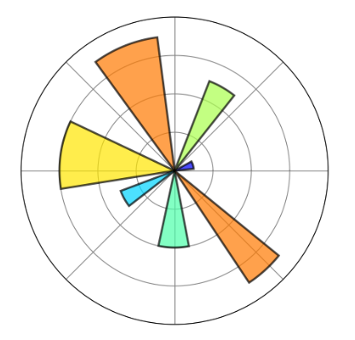
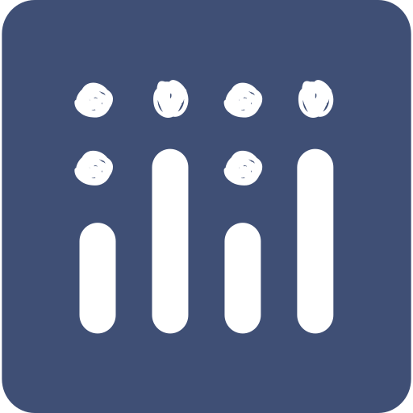

Essential Python Packages
NumPy
SciPy
Pandas
Fast numerical arrays
& math operations
Statistical tests, curve
fitting, signal processing
DataFrames — smart
spreadsheets in code
np.mean([1, 2, 3]) → 2.0
stats.ttest_ind(a, b)
pd.read_csv("data.csv")
Matplotlib
Plotly
Seaborn
Publication-quality
static plots
Interactive plots
for exploration
Beautiful statistical
visualizations
plt.savefig("fig.png", dpi=300)
px.scatter(df, x=..., y=...)
sns.violinplot(data=df)
Don't memorize — just know they exist. Google + docs will guide you.
Abdullah Al Bashit · March 27, 2026
6
Notes:
Six packages with their logos. Pandas is the most important for daily research work.

Slide 7
Introduction to qPCR Data
What is qPCR?
Quantitative Polymerase Chain Reaction (qPCR) measures gene expression levels in real time. Determines how much of a specific mRNA is present in your sample.
RNA
Extraction
Reverse
Transcription
qPCR
Amplification
Fluorescence
Detection
→
→
→
Which probe
was in the well
Machine
output
Physical
position
Example raw data
↓
↓
↓
What data do you get?
Sample | Gene | CT | Well
Cond 2 Rep 1 | Target Gene | 22.04 | A1
Cond 2 Rep 1 | Target Gene | 22.07 | A2
Cond 2 Rep 1 | House Keeping | 7.78 | A3
Cond 2 Rep 1 | House Keeping | 7.97 | A4
Cond 2 Rep 2 | Target Gene | 22.56 | A5
Cond 2 Rep 2 | Target Gene | 22.34 | A6
Cond 2 Rep 2 | House Keeping | 7.73 | A7
Cond 2 Rep 2 | House Keeping | 7.97 | A8
Ct → Cycle Threshold
Lower Ct → a higher initial concentration of the material
· 1 sample = 4 wells (2 genes × 2 tech reps)
· 1 condition = 12 wells (4 wells × 3 bio reps)
· Full experiment = 48 wells
dataset from Dai lab, BioE, NEU
Abdullah Al Bashit · March 27, 2026
7
Notes:
qPCR measures gene expression. Note the equation callouts showing the key formulas.

Slide 8
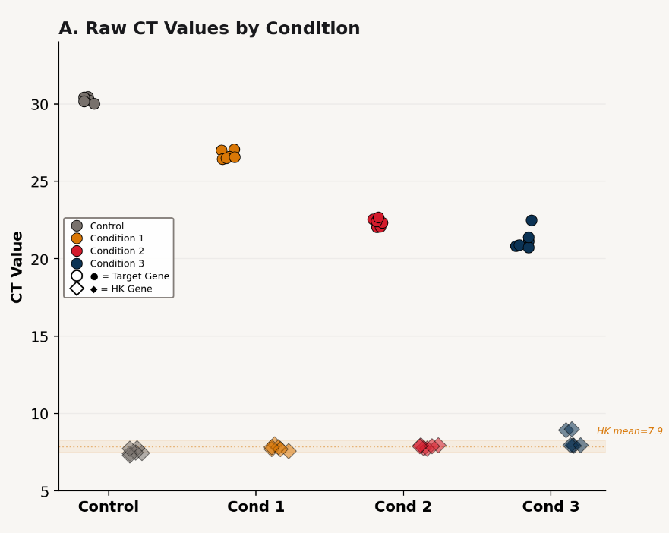
Quality Control: Data Visualization
A Sample Code Block
import pandas as pd
import matplotlib.pyplot as plt
df = pd.read_excel("Sample_Data.ods",
engine="odf")
target = df[df["Gene"]=="Target Gene"]
house = df[df["Gene"]=="House Keeping Gene"]
fig, ax = plt.subplots(figsize=(8, 5))
ax.scatter(range(len(target)),
target["CT"].tolist(),
c="#D41B2C", label="Target", s=60)
ax.scatter(range(len(house)),
house["CT"].tolist(),
c="#D97706", marker="D", label="HK")
ax.set_ylabel("CT Value")
ax.legend()
plt.show()
ax.scatter(x, y, c=color, s=size)
Visualize BEFORE you analyze. Catch errors early!
Abdullah Al Bashit · March 27, 2026
8
Notes:
Always visualize first. Real data from your experiment is shown.

Slide 9
ΔΔCt Pipeline: Data Walkthrough
Sample | Gene | CT
Cond 2 R1 | Target | 22.04
Cond 2 R1 | Target | 22.07
Cond 2 R1 | HK | 7.78
Cond 2 R1 | HK | 7.97
Sample | ct_target | ct_hk | dCT
Cond 2 R1 | 22.06 | 7.88 | 14.18
Cond 2 R2 | 22.45 | 7.85 | 14.60
Cond 2 R3 | 22.57 | 7.90 | 14.67
Cond 3 R1 | 20.99 | 7.93 | 13.06
Cond 3 R2 | 20.82 | 8.46 | 12.36
Cond 3 R3 | 21.94 | 8.49 | 13.46
Cond 1 R1 | 27.04 | 7.87 | 19.17
Cond 1 R2 | 26.54 | 7.71 | 18.82
Cond 1 R3 | 26.53 | 7.77 | 18.76
Control R1 | 30.42 | 7.63 | 22.79
Control R2 | 30.14 | 7.46 | 22.68
Control R3 | 30.30 | 7.52 | 22.78
Step 1: ΔCt
control_mean
ΔCt(ctrl) = = 22.749
Step 1
ΔCt = Ct(target) − Ct(HK)
Step 2: ΔΔCt = ΔCt − ΔCt(ctrl)
Step 2
Step 3: 2^(−ddCT)
ΔΔCt = ΔCt − ΔCt(ctrl)
Sample | dCT | ddCT | 2^(-ddCT)
Cond 2 R1 | 14.18 | −8.57 | 379.2
Cond 2 R2 | 14.60 | −8.15 | 283.7
Cond 2 R3 | 14.67 | −8.08 | 270.6
Cond 3 R1 | 13.06 | −9.69 | 828.1
Cond 3 R2 | 12.36 | −10.39 | 1342.8
Cond 3 R3 | 13.46 | −9.29 | 627.0
Cond 1 R1 | 19.17 | −3.58 | 12.0
Cond 1 R2 | 18.82 | −3.93 | 15.2
Cond 1 R3 | 18.76 | −3.99 | 15.9
Control R1 | 22.79 | 0.04 | 1.0
Control R2 | 22.68 | −0.07 | 1.0
Control R3 | 22.78 | 0.03 | 1.0
Step 3
2^(−ΔΔCt)
Cond 2
Avg: 311
Cond 3
Avg: 933
Cond 1
Avg: 14
Control
Avg: ~1
Abdullah Al Bashit · March 27, 2026
9
Notes:
Expanded data table showing one condition with all replicates. Red bracket = technical replicates (same RNA, same probe, duplicate wells). Navy bracket = same RNA, different probe. Gold bracket = biological replicates (different dishes). Column arrows explain what each column represents.

Slide 10
qPCR Processing: The ΔΔCt Method
Step 1
Step 2
Step 3
ΔCt = Ct(target) − Ct(HK)
ΔΔCt = ΔCt(treat) − ΔCt(ctrl)
Fold = 2^(−ΔΔCt)
df = pd.read_excel("Sample_Data.ods", engine="odf")
# Step 1: Calculate ΔCt
df["delta_ct"] = df["ct_target"] - df["ct_housekeeping"]
# Step 2: ddCt relative to control
control_mean = df[df["group"]=="control"]["delta_ct"].mean()
df["delta_delta_ct"] = df["delta_ct"] - control_mean
# Step 3: Fold change from ddCt
df["fold_ddct"] = 2 ** (-df["delta_delta_ct"])
Code → Math
ΔCt = Target − HK
ΔΔCt = ΔCt − ΔCt_ctrl
Fold = 2^(−ΔΔCt)
Livak & Schmittgen (2001)
Abdullah Al Bashit · March 27, 2026
10
Notes:
ΔΔCt method with equation callouts mapping each code line to its math. 2025 SOP update included.

Slide 11
qPCR Pipeline: Summarizing Results
# Summary stats per group
summary = df.groupby("group").agg(
mean_fold = ("fold_change", "mean"),
std_fold = ("fold_change", "std"),
n = ("fold_change", "count")
).reset_index()
# Calculate SEM
summary["sem"] = (
summary["std_fold"] / np.sqrt(summary["n"])
)
print(summary)
Output: summary
Group | Mean | Std | n | SEM
Control | 1.0 | 0 | 3 | 0
Cond 1 | 14.3 | 2.09 | 3 | 1.21
Cond 2 | 311.2 | 59.3 | 3 | 34.2
Cond 3 | 932.6 | 369.1 | 3 | 213.1
groupby("group").agg(mean, std, count)
→ replaces dozens of manual Excel calcs
SEM = SD / √n
Standard error of the mean
— used for bar plot error bars
Abdullah Al Bashit · March 27, 2026
11
Notes:
Summary table with real data. Note the prominent SEM equation box.

Slide 12
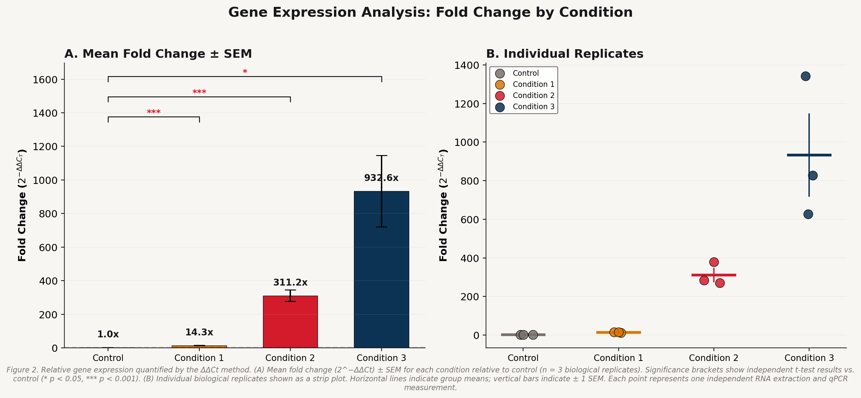
Visualization & Statistics
t_stat, p_val = stats.ttest_ind( df[df[“group"]=="treatment_a"]["fold_change"],
df[df["group"]=="control"]["fold_change"])
Abdullah Al Bashit · March 27, 2026
12
Notes:
Statistical tests with formula callouts. t-test formula, significance thresholds, and extreme values.

Slide 13




Exporting Results
Processed Data
Summary Stats
Figures (raster)
CSV
Excel
PNG 300 DPI
df.to_csv("results.csv", index=False)
summary.to_excel("summary.xlsx")
plt.savefig("fig.png", dpi=300,
bbox_inches="tight")
Figures (vector)
Interactive Plots
Full Report
SVG
HTML
PDF
plt.savefig("fig.svg")
fig.write_html("plot.html")
Jupyter → File → Export as PDF
Pro tip: Save as SVG for journals — resolution-independent and editable in Illustrator.
Abdullah Al Bashit · March 27, 2026
13

Slide 14
Hands-On Exercise
Open the notebook in Google Colab, upload data files from OneDrive, and start!
Notebook: github.com/abdullah-al-bashit/TSS-2026/ > Python for Data Analysis and Automation > qPCR_pipeline.ipynb
Data files: Sample_Data.ods shared on the same github folder
Abdullah Al Bashit · March 27, 2026
14

Slide 15
Acknowledgements
LM
Lee Makowski
Professor, Department of Bioengineering, Northeastern University
CV
Christina Velez
PhD Candidate, Department of Bioengineering, Northeastern University
BA
Bryce Axe
MS, Department of Bioengineering, Northeastern University
… and all the members of the TSS Organizing Committee
Abdullah Al Bashit · March 27, 2026
15

Slide 16

Thank You!
Questions?
The best way to learn Python is to pick a dataset from your own research and try it!

